Slide 1
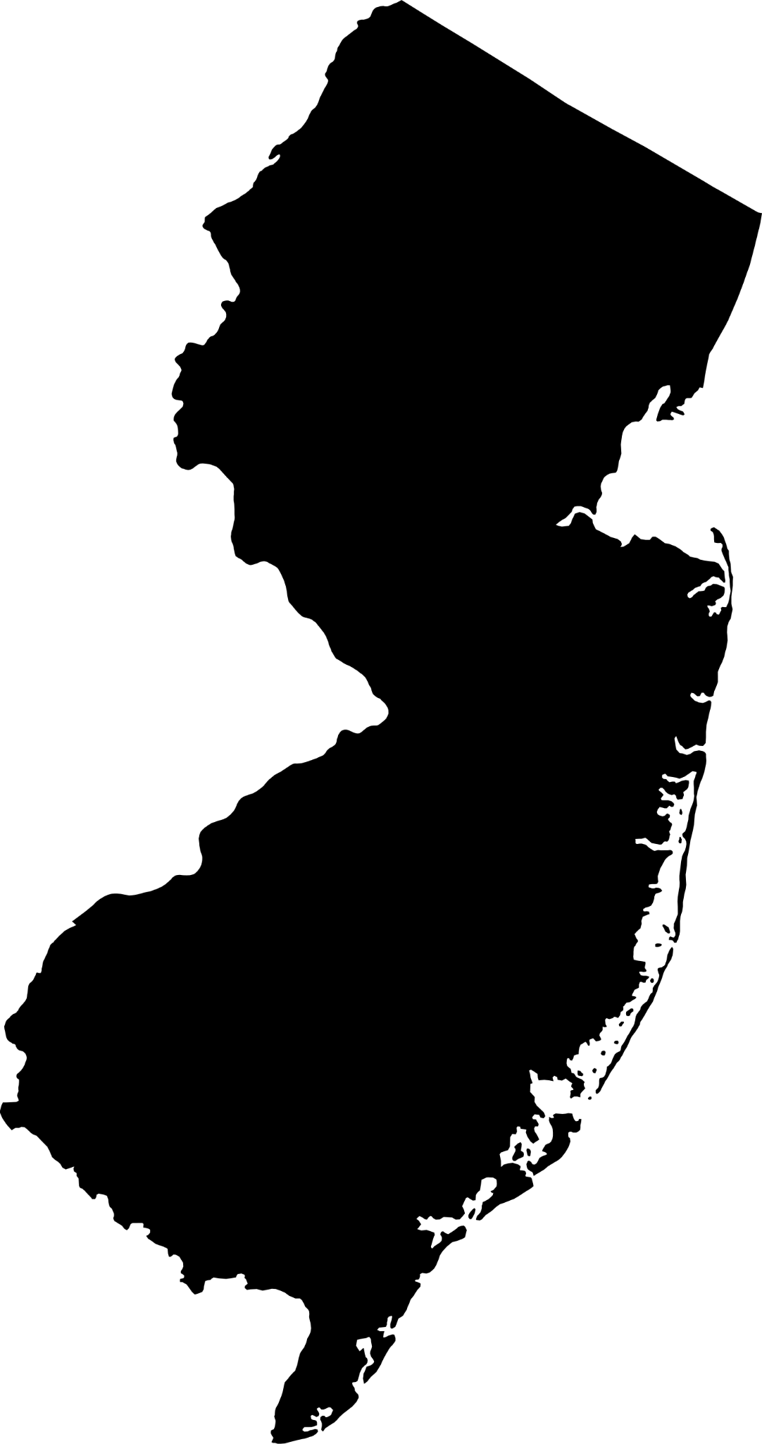
Deaths due to Cerebrovascular Disease in Salem County, NJ
Megha Ravi

Slide 2
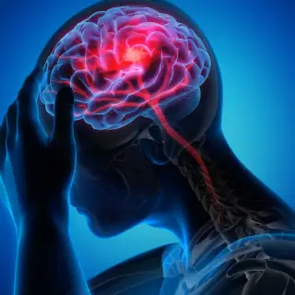
Why is analyzing cerebrovascular disease deaths important?
Cerebrovascular diseases:
“A group of conditions that affect blood flow and blood vessels in the brain”
Includes strokes, brain bleeding, aneurysms, and carotid artery disease
Risk factors: high blood pressure, diabetes, heart disease, smoking, etc
Linked to higher risk: alcohol, illegal drug use, etc
In 2021, strokes were the 5th leading cause of death in New Jersey
Analyzing data aids in creating public health policies that address possible health disparities and resource allocation
Sources:
www.uofmhealth.org
www-doh.state.nj.us
my.clevelandclinic.org
www.cdc.gov/
medlineplus.gov

Slide 3
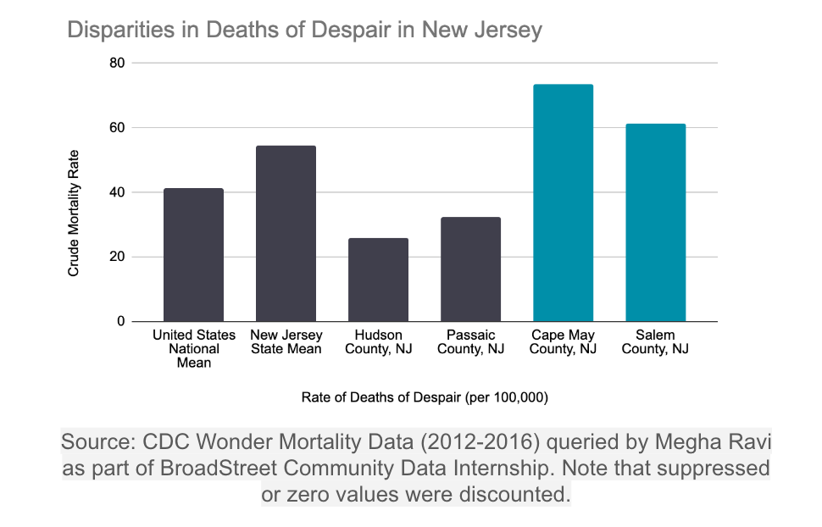
A Look at Salem County, NJ
Most concerning county: Salem
Crude mortality rate: 61.4
Deaths: 198 deaths, about 121 deaths related to Cerebrovascular Disease
Demographics, Health & Economic Factors
21.7% below 18 years of age
19.4% age 65 and older
13.5% Non-Hispanic Black
71.7% Non-Hispanic White vs NJ 52.9%
53.2% Rural vs 6.2% NJ
Adult Obesity: 36% vs 28% NJ
Access to exercise opportunities: 67% vs 96% NJ
Median Income: $77,898 vs $96,346 NJ
Sources:
https://wonder.cdc.gov/
www.countyhealthrankings.org
https://www.njspotlightnews.org
https://data.census.gov/

Slide 4
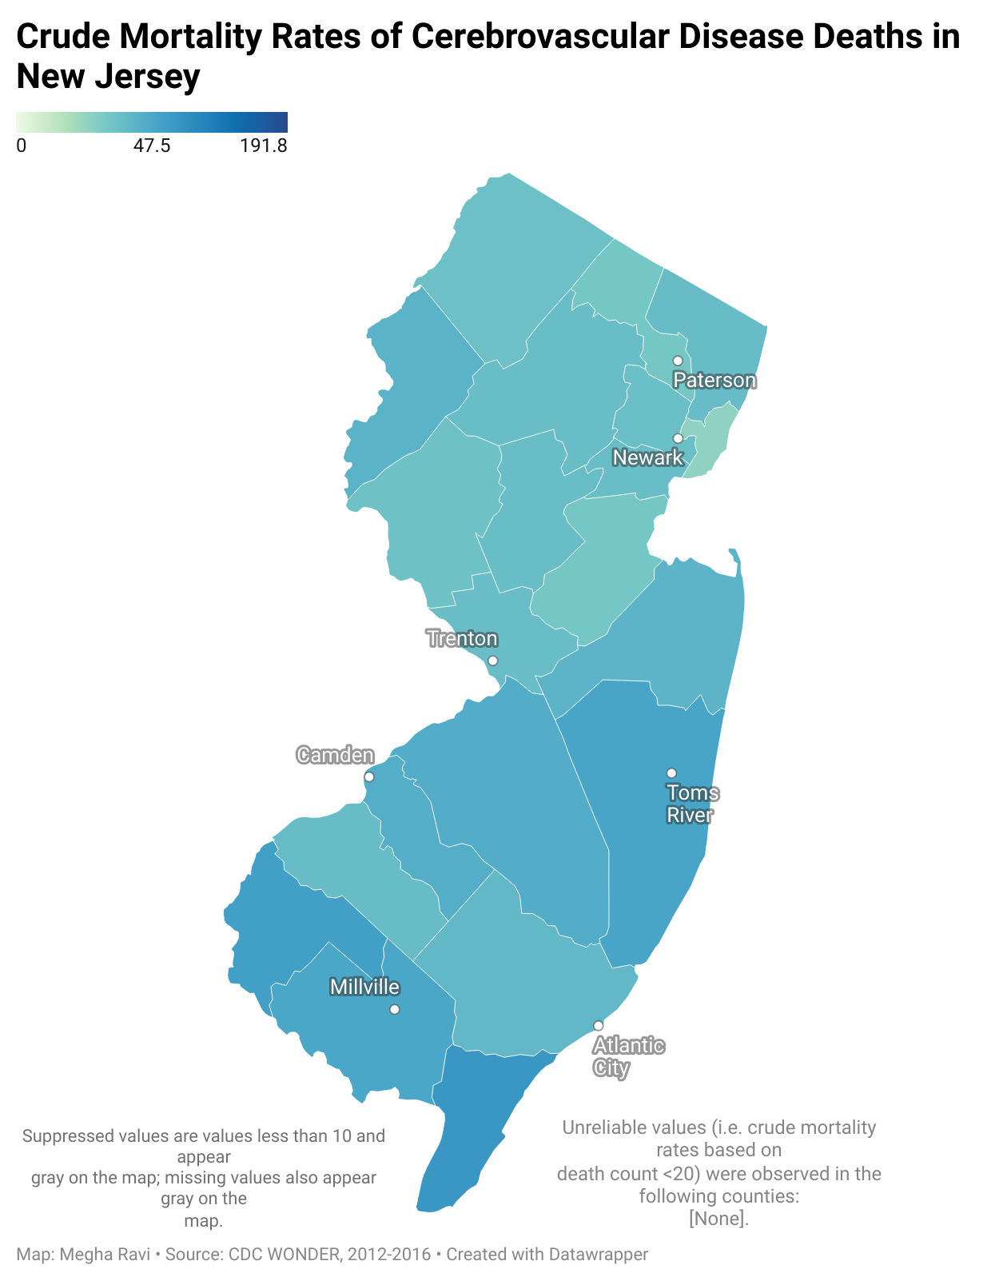
Evidence-Based Interventions (Governmental Path)
Multi-sector collaborations between community orgs, healthcare providers and govt agencies
Salem City Southwest Council supports prevention education
New Jersey Heart Disease and Stroke Prevention Program by the New Jersey Department of Health
Implementing stroke education and awareness programs such as F.A.S.T
Move Yourself Program meant to increase availability of physical activity
Sources:
www.southwestcouncil.org/our-coalitions
www.nj.gov/health/fhs/chronic/heart-disease-stroke/
www.nj.gov/health/hcpnj/documents/county-reports/HCPNJ_fullreports/SALEM_SALEM%20CITY.pdf
https://health.salemcountynj.gov/education/move-yourself/

Slide 5
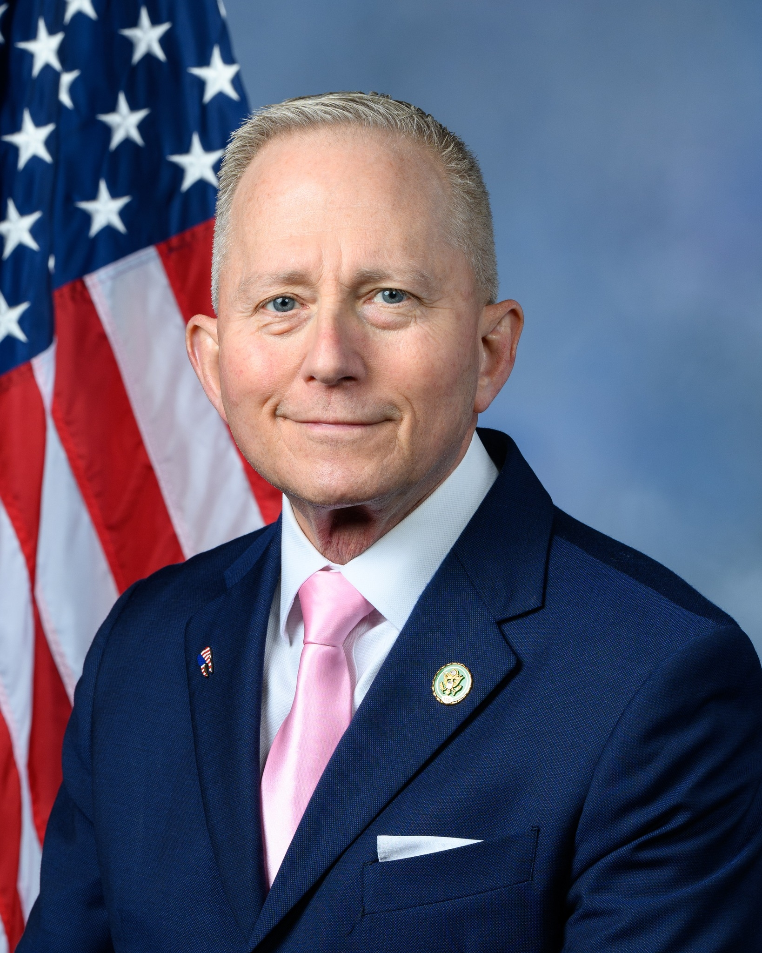
Government Contact for Salem County, NJ
Congressman Jeff Van Drew (District 2 Representative)
Contact Information
(609) 625-5008
Jeff.vandrew@mail.house.gov
Send an email through his website: https://vandrew.house.gov/contact/
Supported grant for overdose prevention, lowering cost of prescription drugs, social security and medicare, funds for South Jersey hospitals
Sources:
https://vandrew.house.gov

